Slide 1
PREDICTIVE MODELING PROJECT
SUBMITED BY ABIN ANTONY P J
Inspired by American express

Slide 2
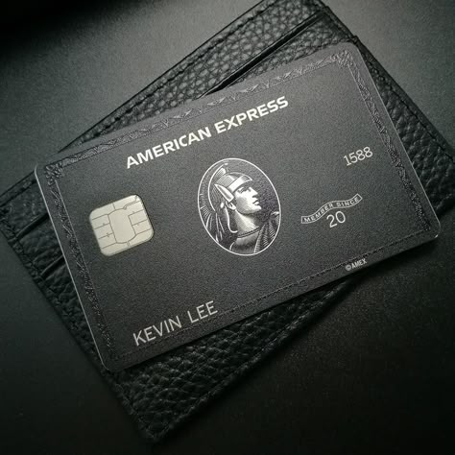

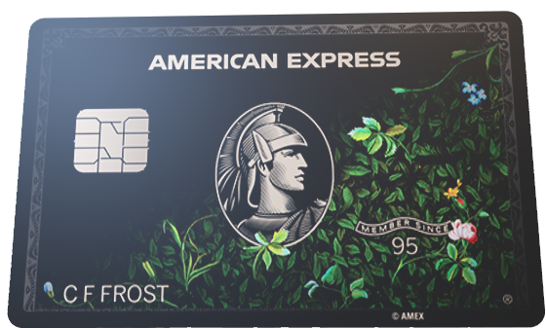
CREDIT CARD FRAUD DETECTION
Leveraging Advanced Machine Learning Techniques for Credit Card Fraud Detection Solutions

Slide 3
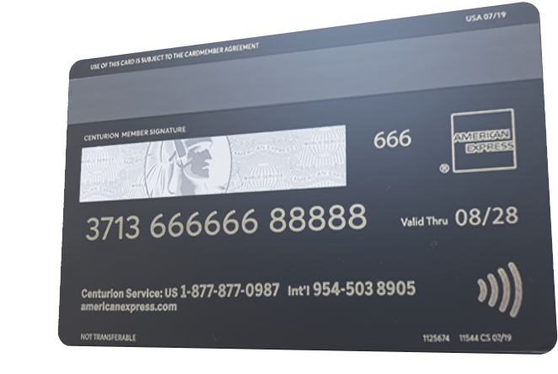
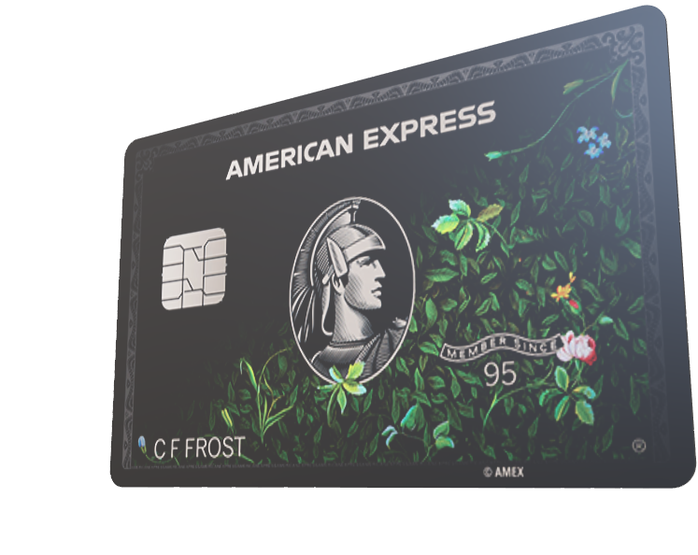
OBJECTIVE
Create a reliable system to detect fraudulent credit card transactions using advanced classification algorithms, ensuring secure and safe transactions

Slide 4
PROCESS AND ALGORITHM SELECTION

Slide 5
DATA EXPLORATION AND CLEANING
MODEL TRAINING AND EVALUATION
MODEL SELECTION AND DEPLOYEMENT
removing irrelevant columns from the dataset
Identifying missing values
Using various CLASSIFICATION models
LOGISTIC Regression
Decision Tree
Random Forest
K Nearest Neighbor
Boosting Algorithms
Choosing the model with the best performance and deploying it for real-time predictions

Slide 6
DATASET

Slide 7
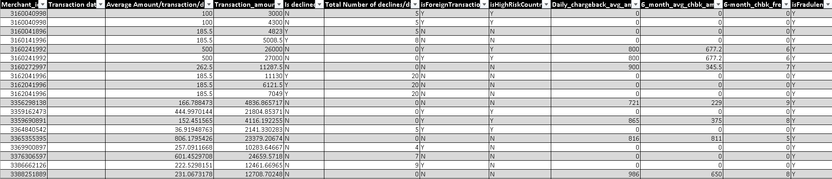
DATASET
Total entries
Total COLUMNS
3075
12

Slide 8
FEATURES & TARGET

Slide 9
FEATURES & TARGET
MERCHANT ID
MERCHANT ID – ( REMOVED )
TRANSACTION DATE – ( REMOVED )
TRANSACTION DATE
AVG. AMOUNT-TRANSACTION-DAY
TRANSACTION AMOUNT
DECLINED
TOTAL NUMBER OF DECLINES PER DAY

Slide 10
FEATURES & TARGET
FOREIGN TRANSACTION
Fraudulent STATUS – ( TARGET )
HIGH RISK COUNTRY
DAILY CHARGEBACK AVG. AMOUNT
6 MONTH AVG. CHARGEBACK AMOUNT
6 MONTH CHARGEBACK FREQUENCY
Fraudulent STATUS

Slide 11
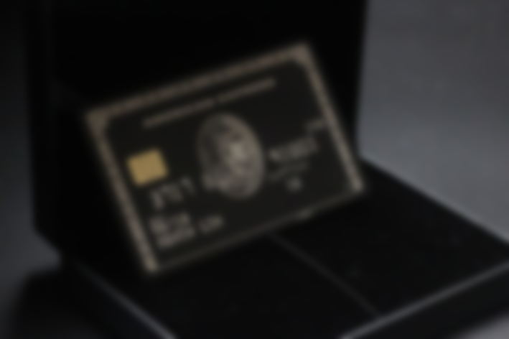
OPTIMIZING PREDICTIONS WITH CLASSIFICATION MODELS

Slide 12
KEY INSIGHTS

Slide 13
LOGISTIC REGRESSION
Training accuracy – 98%
Testing Accuracy - 99%
DECISION TREE CLASSIFIER
Training accuracy – 100%
Testing Accuracy - 98%
KEY INSIGHTS
RANDOM FOREST CLASSIFIER
Training accuracy – 100%
Testing Accuracy - 99%

Slide 14
KNN CLASSIFIER
Training accuracy – 98%
Testing Accuracy - 98%
LOGISTIC REGRESSION
Training accuracy – 98%
Testing Accuracy - 99%
ADABOOST CLASSIFIER
Training accuracy – 95%
Testing Accuracy - 96%
DECISION TREE CLASSIFIER
Training accuracy – 100%
Testing Accuracy - 98%
KEY INSIGHTS
GRADIENT BOOST CLASSIFIER
Training accuracy – 99%
Testing Accuracy - 99%
RANDOM FOREST CLASSIFIER
Training accuracy – 100%
Testing Accuracy - 99%
BEST MODEL
RANDOM FOREST - CLASSIFIER

Slide 15
KNN CLASSIFIER
Training accuracy – 98%
Testing Accuracy - 98%
ADABOOST CLASSIFIER
Training accuracy – 95%
Testing Accuracy - 96%
COMPARISON TABLE
GRADIENT BOOST CLASSIFIER
Training accuracy – 99%
Testing Accuracy - 99%

Slide 16
COMPARISON TABLE
ALGORITHMS | TRAINING ACCURACY | TESTING ACCURACY | PRECISION SCORE | RECALL SCORE | F1 SCORE
LOGISTIC REGRESSION | 98% | 99% | 97% | 95% | 96%
DECISION TREE CLASSIFIER | 100% | 98% | 96% | 93% | 94%
RANDOM FOREST CLASSIFIER | 100% | 99% | 97% | 95% | 96%
KNN CLASSIFIER | 98% | 98% | 96% | 95% | 96%
ADABOOST CLASSIFIER | 95% | 96% | 98% | 76% | 85%
GRADIENT BOOST CLASSIFIER | 99% | 99% | 97% | 95% | 96%

Slide 17
USER - INTERFACE

Slide 18
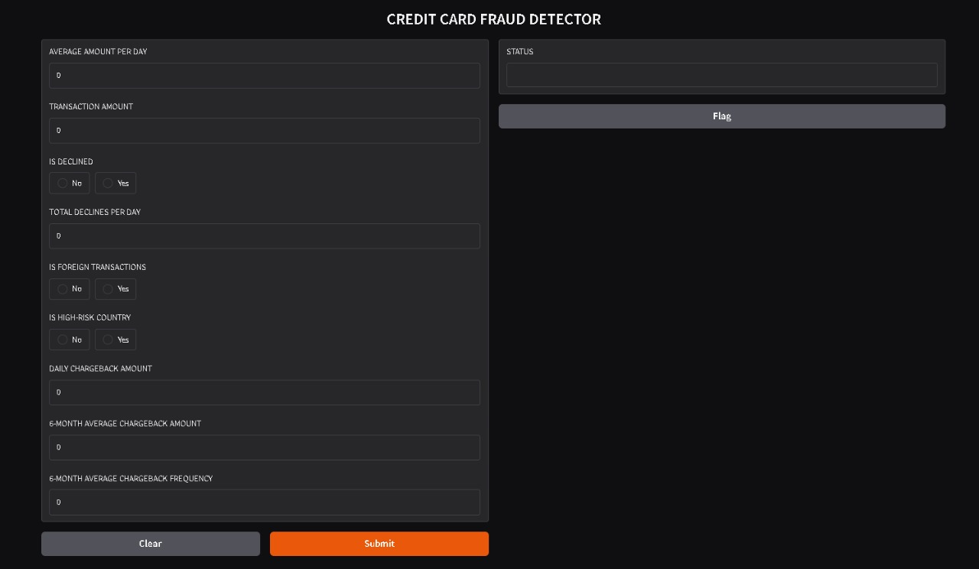
USER - INTERFACE

Slide 19
MODEL - IMPLEMENTATIONS

Slide 20
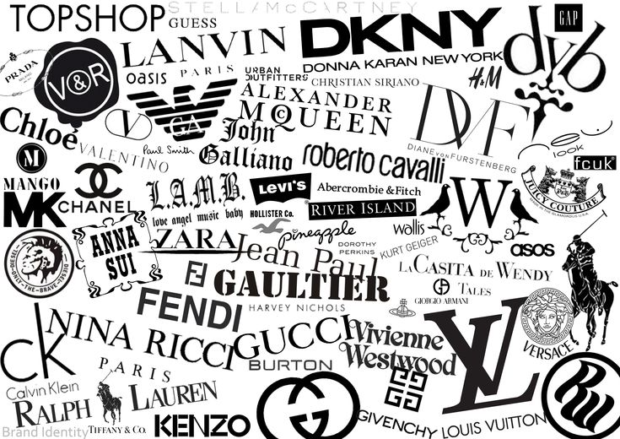

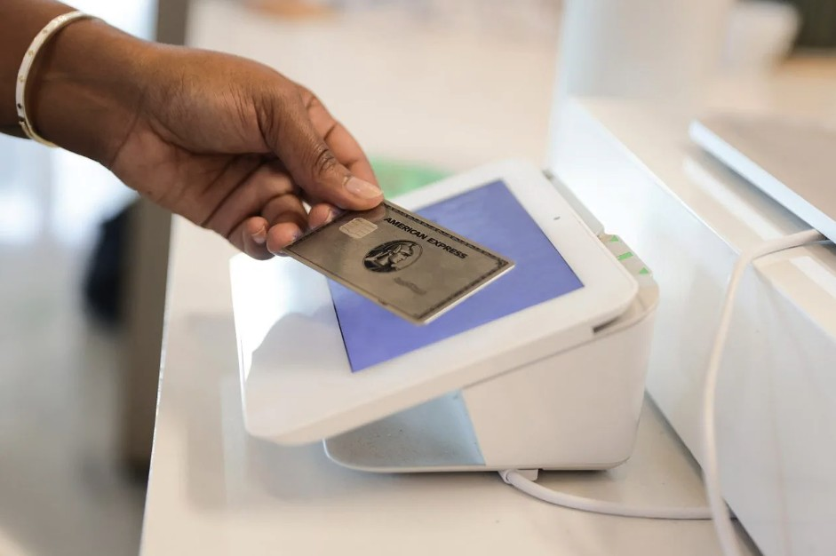
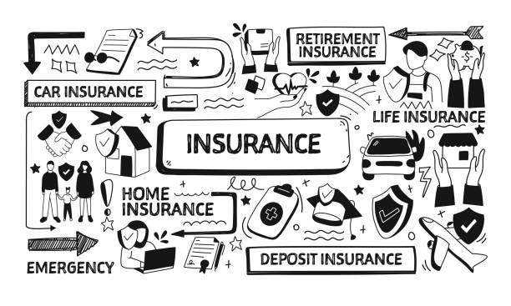
MODEL - IMPLEMENTATIONS
E-commerce platforms
BANKING SYSTEMs
PAYMENT PROCESSORS
INSURANCE Companies

Slide 21
CONCLUSION

Slide 22
Machine learning - Enhances fraud detection
CONCLUSION
REFERENCE
identify suspicious activities
enhancing real-time transaction security
adapts to evolving fraud tactics
spots fraudulent behaviour instantly

Slide 23
Machine learning - Enhances fraud detection
REFERENCE
identify suspicious activities
enhancing real-time transaction security
adapts to evolving fraud tactics
spots fraudulent behaviour instantly

Slide 24


REFERENCE
AMEX
KAGGLE - DATASET
GRADIO - UI
AMERICAN EXPRESS

Slide 25
THANK YOU
AMEX
SUBMITED BY ABIN ANTONY P J
Inspired by American express

